Slide 1
SAFETY ALARM APP

Slide 2
Introduction
In today's time safety has become the most priority of the Indian Government considering the rising cases of crime against both men and women. There are many applications which are built for women and for their safety like Kavalan.
All these required internets, but our application is different, In many situation people don't have internet connection. So, we can solve the problem with our application which work without internet services.
A Safety Alert App project is a mobile application which ensures that peoples are stays safe always. This application is developed in Android platform.

Slide 3
Abstract:
In this modern time, it will hazardous to travel alone for a person at night especially for women. To provide safety and reduce the chance of becoming victim of violent crime it is necessary to have an app which safe for you, it is identify and call on resources to help you out from unsafe situations.In today time, people using smart phones has rapidly increased, a smart phone is essential need of everyone in today time, so smart phone can be used efficiently for individual security or various another defense.This android application is for the safety of the people and this app can be activated by the single click, whenever need is arising. A single click will identify the location of the place through the GPS system and send SMS to the registered contact.

Slide 4
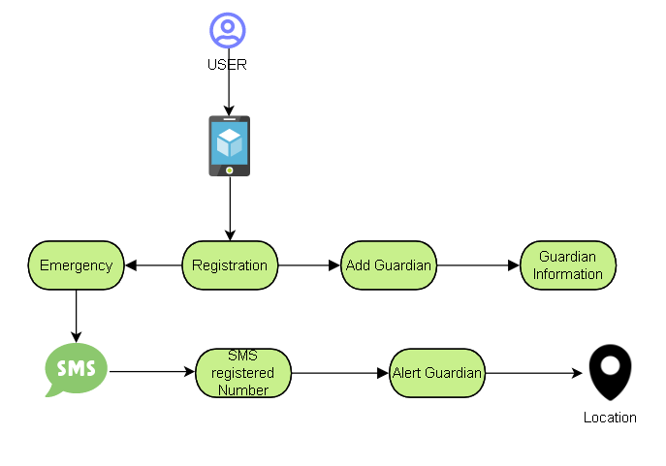
Architecture Diagram:

Slide 5
System requirements:
Project Platform: Kotlin.
PC contains windows :10/11 .
Minimum required RAM: 4 GB RAM.
Mobile with android version 7.0 or above.
Mobile with Min RAM : 4GB.
IDE tool :Android Studio.

Slide 6
Modules:
Guardian Details: Here, you can add or delete the list of guardians with their respective phone numbers .
Check Location: Here, you will get the current location of the user by adding a marker on the inbuilt google map.
Emergency: This plays an important role in the app. It sends an instant text message and mail to the list of guardians. The message contains the current location of user with google map link created.

Slide 7
Features
Easy to implement
Easy to understand
Send SOS to registered mobile
Send Last Known Location to registered mobile

Slide 8
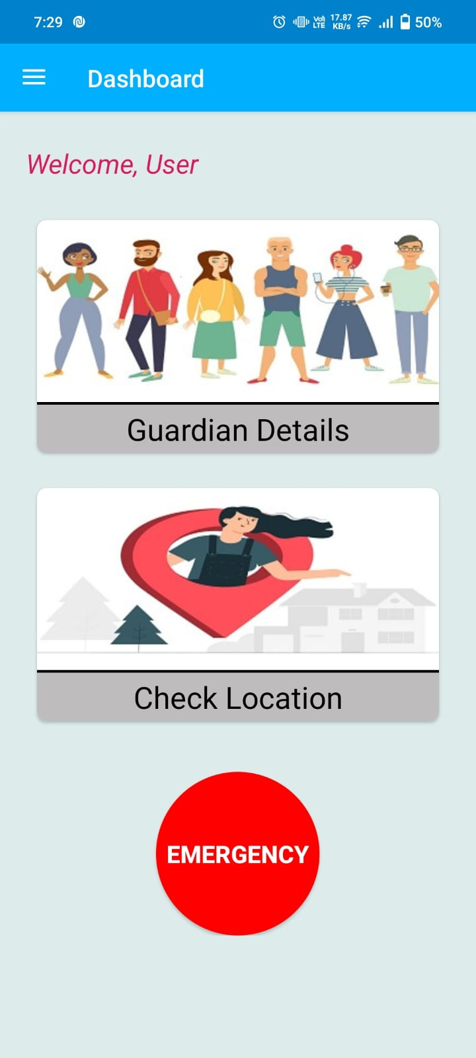
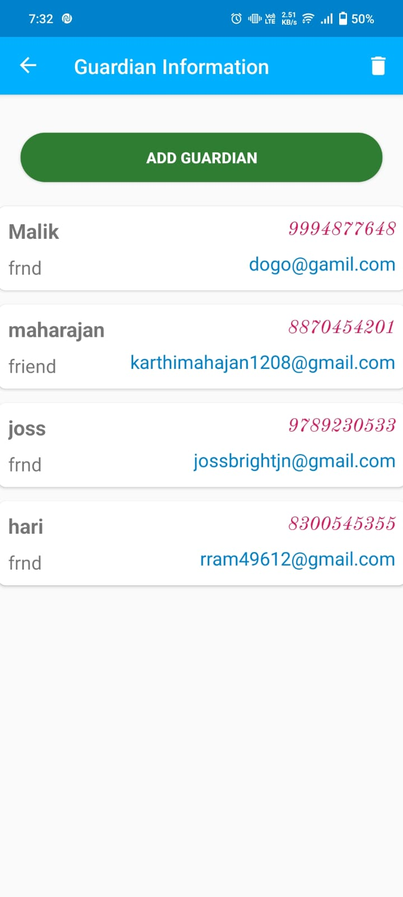
Output:

Slide 9
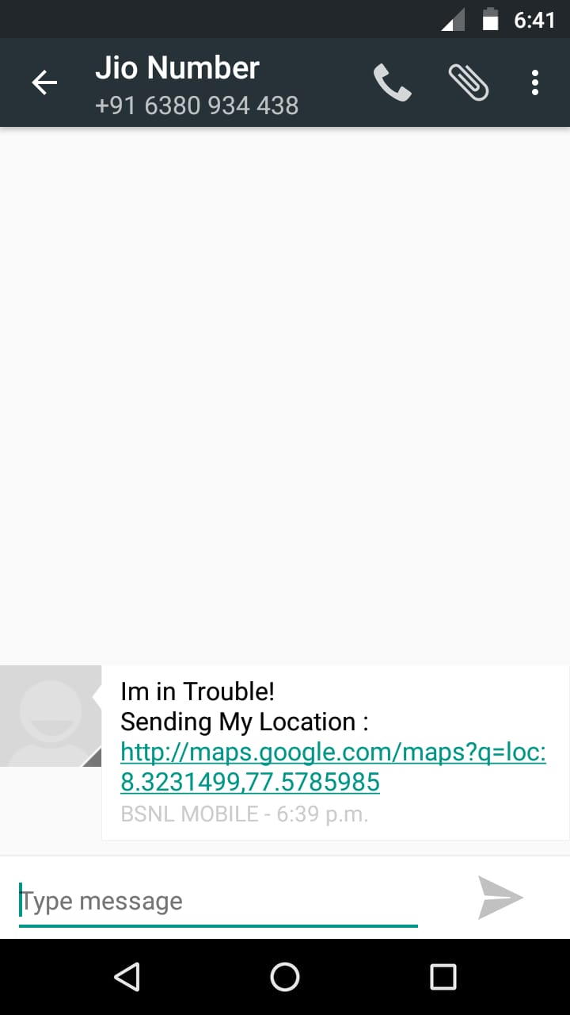
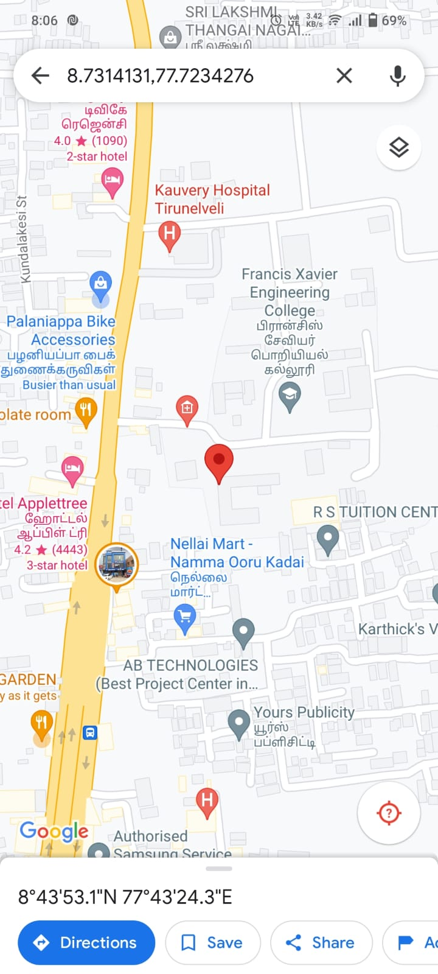

Slide 10
CONCLUSION: In conclusion,Security Alarm app that is designed in android platform for safety of people with the aid of recent improvements in mobile technology. We have developed an application which is useful for the users,when he/she is in some problem or needs any help.When the user opens this application,user can see a EMERGENCY button.Also,Users can store multiple contact numbers. When the user is in some difficulty or needs any help,the user opens this application and they can see a EMERGENCY button.Click that button to send SMS to register guardian.Continuous location tracking information via SMS helps to find the location of the victim quickly and can be rescued safely.This application aims to ensure safety for everyone through our safety alarm app.

Slide 11
Thank You

